Slide 1

Unit I : Introduction To Systems Programming And Assemblers Language Processor and Compiler Construction
Manisha Mali
manisha.mali@viit.ac.in
Department of Computer Engineering
BRACT’S, Vishwakarma Institute of Information Technology, Pune-48
(An Autonomous Institute affiliated to Savitribai Phule Pune University)
(NBA and NAAC accredited, ISO 9001:2015 certified)

Slide 2
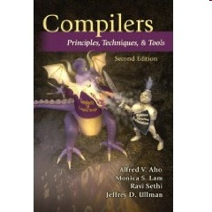
Books
D. M. Dhamdhere, Systems Programming and Operating Systems, Tata McGraw-Hill, ISBN 13:978-0-07-463579-7, Second Revised Edition
Alfred V. Aho, Ravi Sethi, Jeffrey D. Ullman, Compilers Principles, Techniques and Tools, Addison Wesley, ISBN:981–235–885 - 4, Low Price Edition
J. J. Donovan, Systems Programming, McGraw-Hill, ISBN 13:978-0-07-460482-3, Indian Edition
J R Levin, T Mason, D Brown, “Lex and Yacc", O'Reilly, 2000 ISBN 81-7366-061-X

Slide 3
Course Prerequisite
Fundamentals of Data structures
Theory of Computation : DFA, NFA, Regular expressions, Grammars
Concepts of Operating Systems
Programming Languages

Slide 4
Course Outcomes
1. Develop hypothetical assembler. (Apply)
2. Illustrate macro processors, linkers and loaders. (Understand)
3. Implement lexical analyser using LEX tool (Apply)
4. Build parser using YACC tool (Apply)
5. Construct the intermediate code representations (Apply)
6. Demonstrate code optimization and code generation concept (Understand)

Slide 5
Content
Part – I : Introduction
Need of System Software,
Components of System Software
Language Processing Activities
Fundamentals of Language Processing
Interpreter
Part- II : Assemblers
Elements of Assembly Language Programming
A simple Assembly Scheme
Pass structure of Assemblers
Design of Two Pass Assembler

Slide 6
Introduction
Software
Application software usually used by end-user
It is concerned with the solution of some problem, using the computer as a tool, instead of how computers actually work.
System software
System software consists of a variety of programs that support the operation of a computer (ex: text editor, compiler, debugger)
One characteristic in which most system software differ from application software is machine dependency
A system software programmer must know the target machine structure

Slide 7
Types of System Software
Operating System
Language Processors
Device Drivers

Slide 8
Basic Features and Design Options
Fundamental features
Basic functions and characteristics should remain essentially the same, regardless of what machine is being used.
Major design options
There is no single “right” way of doing things; a software designer needs to be aware of the available options in order to make intelligent decisions

Slide 9
System Software and Machine Architecture
Machine dependent system software
System programs are to support the operation and use of the target computer.
The difference between different machine
Machine code
Instruction formats
Addressing mode
Registers
Machine independent system software
General design and logic is basically the same:
Code optimization
General design and logic of an assembler

Slide 10
System Software
The system software includes
Assembler
Linker
Loader
Macro processor
Text editor
Compiler
Operating system
Debugging system
Source Code Control System
(optional) Database Management System

Slide 11
Programming Languages
Machine language:
It is computer’s native language having a sequence of zeroes and ones (binary). Different computers understand different sequences. Thus, hard for humans to understand:
e.g.0101001...
Assembly language:
It uses mnemonics for machine language. In this each instruction is minimal but still hard for humans to understand:
e.g. ADD AH, BL
High-level languages:
FORTRAN, Pascal, BASIC, C, C++, Java, etc. Each instruction composed of many low-level instructions, closer to English. It is easier to read and understand:
e.g. hypot = sqrt(opp*opp + adj * adj);

Slide 12
Language processors
A Language processor is a software which bridges a specification or execution gap
Specification Gap
Execution Gap
Application
Domain
PL Domain
Execution
Domain

Slide 13
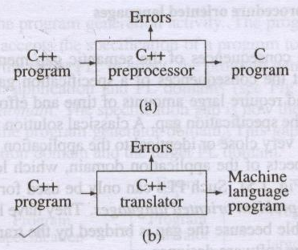
Language processors
A language translator
A detranslator
A preprocessor
A language migrator
Interpreter

Slide 14
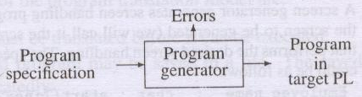
Program generation activities

Slide 15
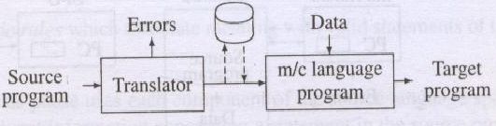
Program execution activities
i Program translation
ii Program interpretation

Slide 16
Fundamentals of language processing
Language processing = Analysis of source program
+ synthesis of target program
Lexical rules
Syntax rules
Semantic rules

Slide 17
Fundamentals of language processing (Contd.)
Phases of a language processor
Forward reference
Passes of a language processor
Intermediate representation

Slide 18
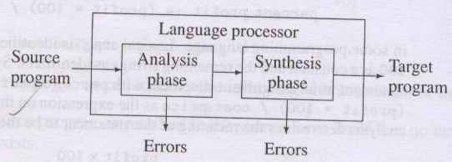
A. Phases of a language processor

Slide 19
B Forward reference
A FR of a program entity is a reference to the entity which precedes its definition in the program

Slide 20
C. Passes of a language processor
Pass I
Performs analysis of the source program and note relevant information
Pass II
Perform synthesis of target program

Slide 21
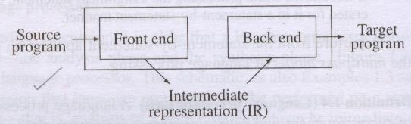
D. Intermediate representation

Slide 22
Fundamentals of language specification
Programming language grammar
Terminal symbols, alphabets and strings
Classification of grammar
Type-0 grammar
Type-1 grammar
Type-2 grammar
Type-3 grammar
Operator grammar

Slide 23
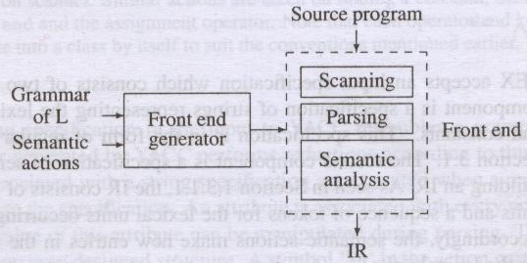
Language processor development tools

Slide 24
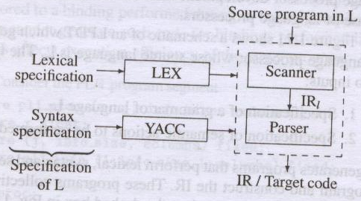
Language processor development tools (Contd)

Slide 25
What is a Compiler?
Source Language
L
Compiler
Target Language
L’
Java
C++
FORTRAN
JVM
Intel Pentium
MIPS
IBM’s CELL
A compiler translates text from a source language, L, to
A target language, L’.

Slide 26
Interpreter
An interpreter is a computer program, which coverts each high-level program statement into the machine code. This includes source code, pre-compiled code, and scripts. Both compiler and interpreters do the same job which is converting higher level programming language to machine code. However, a compiler will convert the code into machine code (create an exe) before program run. Interpreters convert code into machine code when the program is run.
Ref : https://www.guru99.com/difference-compiler-vs-interpreter.html

Slide 27
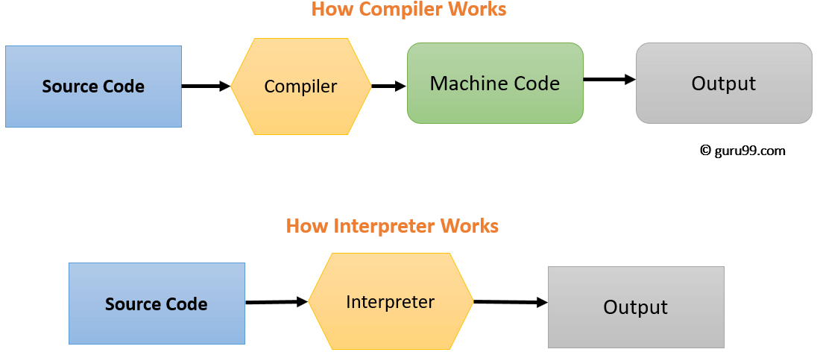

Slide 28
Architecture
Compiler:
assembly code
machine code
machine code
source program
result
compiler
assembler
linker
loader
libraries
data
Interpreter:
source program
result
interpreter
data
Java uses both a compiler (javac) and an interpreter (java)‏

Slide 29
Role of Interpreter
The interpreter converts the source code line-by-line during RUN Time.
Interpret completely translates a program written in a high-level language into machine level language.
Interpreter allows evaluation and modification of the program while it is executing.
Relatively less time spent for analyzing and processing the program
Program execution is relatively slow compared to compiler

Slide 30
Key Difference between Compiler and Interpreter
Compiler transforms code written in a high-level programming language into the machine code, at once, before program runs, whereas an Interpreter coverts each high-level program statement, one by one, into the machine code, during program run.
Compiled code runs faster while interpreted code runs slower.
Compiler displays all errors after compilation, on the other hand, the Interpreter displays errors of each line one by one.
Compiler is based on translation linking-loading model, whereas Interpreter is based on Interpretation Method.
Compiler takes an entire program whereas the Interpreter takes a single line of code.

Slide 31
Many Other Translators
Source Language Translator Target Language
LaTeX Text Formater PostScript
SQL database query optimizer Query Evaluation Plan
Java javac compiler Java byte code
Java cross-compiler C++ code
English text Natural Lang Understanding semantics (meaning)‏
Regular Expressions JLex scanner generator a scanner in Java
BNF of a language CUP parser generator a parser in Java

Slide 32
Challenges
Many variations:
many programming languages (eg, FORTRAN, C++, Java)‏
many programming paradigms (eg, object-oriented, functional, logic)‏
many computer architectures (eg, MIPS, SPARC, Intel, alpha)‏
many operating systems (eg, Linux, Solaris, Windows)‏

Slide 33
References
D. M. Dhamdhere, Systems Programming and Operating Systems, Tata McGraw-Hill, ISBN 13:978-0-07-463579-7, Second Revised Edition
Alfred V. Aho, Ravi Sethi, Jeffrey D. Ullman, Compilers Principles, Techniques and Tools, Addison Wesley, ISBN:981–235–885 - 4, Low Price Edition
J. J. Donovan, Systems Programming, McGraw-Hill, ISBN 13:978-0-07-460482-3, Indian Edition
J R Levin, T Mason, D Brown, “Lex and Yacc", O'Reilly, 2000 ISBN 81-7366-061-X
https://www.guru99.com/difference-compiler-vs-interpreter.html

Slide 34


